Slide 1
Lecture Frame
A digital lecture recording system with minimized storage size.
Hamza Farooq. UET Lahore

Slide 2
Material
Infrared Transmitters and receivers.
Descendant counters
Single Precision Timers
And gates
16-bit microprocessor
Serial Connection
Windows application

Slide 3
Hardware Part
Infrared emitters emit an infrared beam from starting to ending position successively.
There is only 1 transmitter and receiver active at a time in each parallel pair for increased precision.
Descendant counters and precision timers are used to maximize bandwidth.
Microprocessor is used as a driver and to send the current touch position to windows application through serial connection.

Slide 4
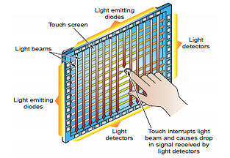
Implementation Demo

Slide 5
Software Part
Application will
Read the incoming serial data and plot it on screen.
Draw the projection of each touch input in multi-touch case at same time.
Record audio and plotting data simultaneously.
Save the file containing audio and plotting data.
Load and play the file containing audio and plotting data.

Slide 6
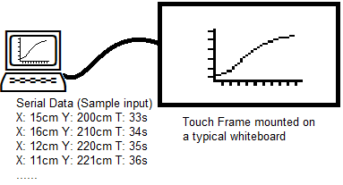
Software part (Input)
Application will get three parameters as input X position (cm) Y position (cm) Current time (seconds)

Slide 7
Software Part (Output)
Application will
Read the serial data and plot a curve on computer screen.
Record audio as well.
Save both audio and serial data as a single file so that user can view the recorded lecture later after.
Play the saved lecture file.

